Slide 1
Introduction to Spring Boot
MODULE 1 – Spring boot

Slide 2
Presentation Contents
What is a Spring Boot?
Database types
Database objects

Slide 3
Course objectives
Learn what is Spring Boot?
What problems does it solve & why do we use it?
Exposing the application via REST.
Coding application business logic.
Interacting with a database.

Slide 4
What is a Spring Boot?
Spring Boot is an addition to the Spring Framework that allows us to create a production ready applications fast that just run.
“Opinionated” configuration
Dependencies
Embedded Server
Notes:
Opinionated” configuration – configures Spring for us in a way that is applicable for practically any application.
Dependencies – access to external libraries that facilitate developing a web application.
Embedded Server – Embedded Tomcat server within the application to allow us to run it from anywhere.

Slide 5
Configuration Problem
One of the issues using Spring is how versatile it is and how much it can do.
This becomes a problem due to an application becoming very heavy on the amount of configuration developers need to do in order to make it work.
Spring Framework
Spring MVC
Spring Data
Spring Security
Spring Social
Spring Web Services
And Many more…

Slide 6
Spring Boot Configuration
For the majority of enterprise applications configuration is identical of very similar.
This is where Opinionated Spring Boot comes in:-
Setting defaults for the configuration.
Done behind the scenes and works “Out of the Box”
Notes:
Occasionally some stuff requires de-configuring we should be aware.

Slide 7
Convention over Configuration
This is known as “convention over configuration” following a number of established industry best practices so it doesn’t have to be repeated from scratch each time a new application is created.
Notes:
For example - application.properties - should you need to tell Spring Boot where this goes? It abides by convention and tells you where things should go, for instance putting application.properties into src/main/resources.

Slide 8
Dependencies
Don’t reinvent the wheel
e.g. front-end developers do not want to have to write the code to create new buttons each time they start a new application.
Their solution is to import, as dependencies, buttons that have been created elsewhere making use of or modifying them where necessary.
The same logic applies to functions within an application; If a code solution for some functionality exists it is we should import the library as a dependency.

Slide 9
Spring Boot Dependencies
This is a large part of what frameworks are: collections of dependencies available to us.
We use Maven as a dependency manager allowing us to add dependencies to the pom.XML
Dependency management is a difficult task for big projects. Spring Boot resolves this problem by providing a set of dependencies for developers convenience. There are a few we can use like:
spring-boot-starter-web
spring-boot-starter-security
spring-boot-starter-test

Slide 10
Activity: Spring Boot Dependencies
Directions
15 minutes, groups.
Go to https://spring.io/projects and pick a project
Look at some of the libraries that make up the project and what they are used for.
Debrief
Feedback to the class the results of what the libraries you researched are used for.
What does this project enable us to do?

Slide 11
Spring Boot Embedded Tomcat
Usually to run a web application we need to package the application into a WAR (Web Archive) file and deploy it to an application server.
Tomcat (the application server) is embedded into the Spring Boot application along with all of the other dependencies.
Now there is no need for creating WAR files the application can be simply packaged as a JAR that can be run on any JVM.
Notes:
This is extra work setting up the web server and caused problems: –
applications could only run in specific locations with the correctly configured application server – they were not executable on their own.
When updating versions of the application it was not always compatible with the server and vice versa.
This gives us the benefit of applications being “server agnostic” meaning they will run on any server.
Removing the extra steps and the quick start-up is particularly beneficial now that microservice architecture is becoming the standard and we’re regularly changing and starting up lots of small applications

Slide 12
Benefits of an Embedded Server?
Notes:
This is extra work setting up the web server and caused problems: –
applications could only run in specific locations with the correctly configured application server – they were not executable on their own.
When updating versions of the application it was not always compatible with the server and vice versa.
This gives us the benefit of applications being “server agnostic” meaning they will run on any server.
Removing the extra steps and the quick start-up is particularly beneficial now that microservice architecture is becoming the standard and we’re regularly changing and starting up lots of small applications

Slide 13
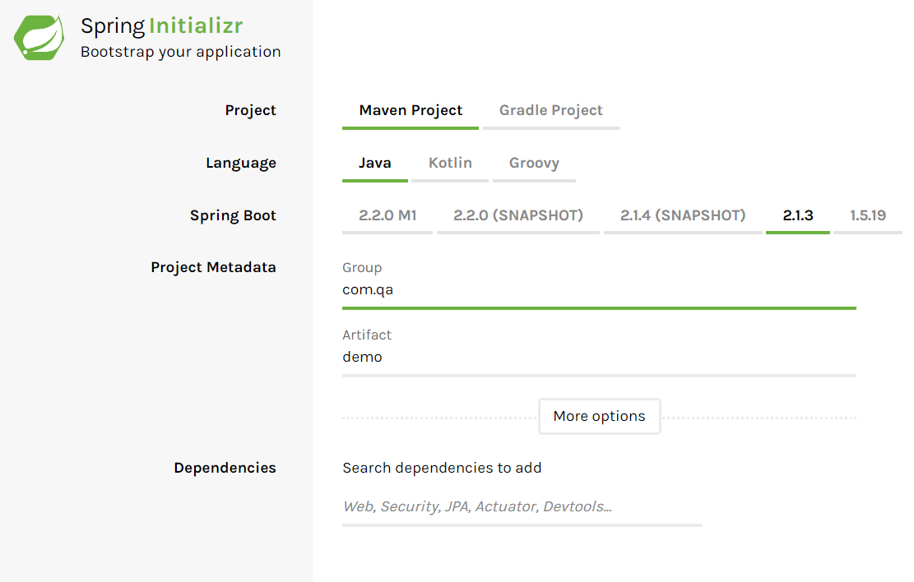
Spring Initializr
Spring Initializr is a tool to create the structure of a Spring Boot application.
Choose your dependencies
Click generate project
Import the project as an existing Maven project into eclipse

Slide 14
Follow along with slide demo
Simple project – h2 and tomcat

Slide 15
Adding a database
Maven facilitates the addition of a database to the application.
For an in memory database like H2 adding the dependency in the pom.xml imports the jar files for H2.
Notes:
The H2 database is almost ready to use simply by adding this dependency. With a little added configuration to inform Spring you’re using a H2 database all the auto implemented methods from the previous slide will be able to be used to interact with the database.

Slide 16
Annotations
Custom Spring annotations are used frequently in Spring applications.
Notes:
@SpringBootApplication defines the class as the main application runner.
A class annotated with @SpringBootApplication is now also a configuration class for beans. Beans can now be defined Spring will look for bean definitions within this class at runtime.
As seen in this image – when an instance of the employee service needs to be created spring will look for a method that returns an employee service that is annotated with @Bean.
All other components in the application with their own annotations (@Repository, @Entity, etc.) are seen as children of this class, so a class marked with @SpringBootApplication must be located at the top of the package structure.

Slide 17
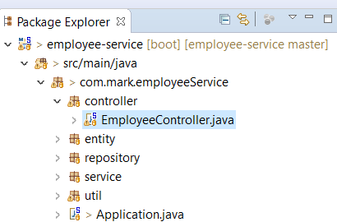
Exposing the Application
Exposing the application means allowing the objects to be accessed.
This is how you interact with your application externally.
The class where you expose the application is called the “controller”.

Slide 18
REST and the HTTP methods
We can communicate with the application via REST using HTTP methods.
The most common HTTP methods:
POST
GET
PUT
DELETE
Notes:
The default operation of HTTP is GET, which is intended to be used when getting data from the server. However, HTTP defines a number of other methods, including PUT, POST and DELETE.
The REST philosophy asserts that to delete something on the server, you would simply use the URL for the resource and specify the DELETE method of HTTP. For saving data to the server, a URL and the PUT method would be used. For operations that are more involved than simply saving, reading or deleting information, the POST method of HTTP can be used.

Slide 19
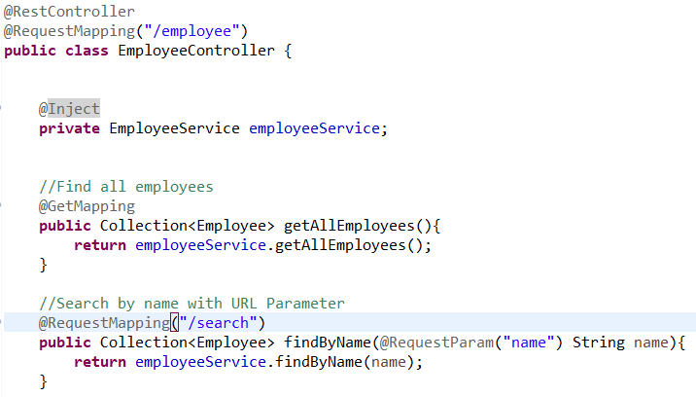
Controller
The @RestController annotation defines the class as the controller.
The URL location is known as the “endpoint”.
@RequestMapping with “/employee” is constructing the URL where the methods can be reached.
e.g. http://localhost:8080/employee

Slide 20
GET request
Then the methods within the controller class are annotated with the HTTP method that is used to call it.
In this example sending a GET request to http://localhost:8080/employee will call the getAllEmployees method.

Slide 21
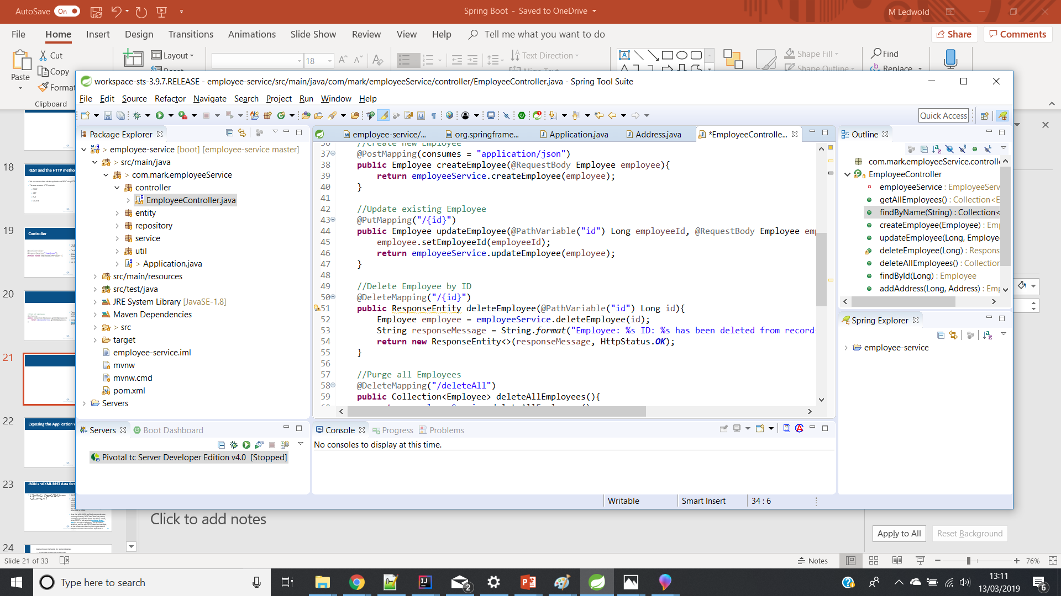
DELETE Request
Adding additional parameters further specifies the URL.
In this example sending a DELETE request to http://localhost:8080/employee/deleteAll will call the deleteAllEmployees method.

Slide 22
PUT Request
The example sending a PUT request to http://localhost:8080/employee/1 will call the updateEmployee method for employee 1.
{id} is a placeholder for which id is used in the request.

Slide 23
JSON and XML REST data formats
JSON response requesting an employee
The example shows JSON used as the data exchange format for the RESTful interaction. The two most common data exchange formats are JSON and XML.
Notes:
Many RESTful web services can use both formats interchangeably, as long as the client can request the interaction to happen in either XML or JSON.
Note that while JSON and XML are popular data exchange formats, REST itself does not put any restrictions on what the format should be. In fact, some RESTful web services exchange binary data for the sake of efficiency. This is another benefit to working with REST-based web services, as the software architect is given a great deal of freedom in terms of how best to implement a service.

Slide 24
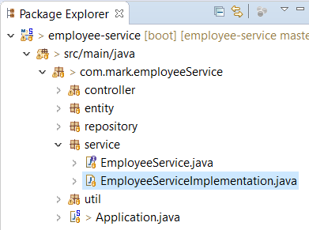
Service Layer
The controller is the entry point to the application but processing isn’t done there.
The service layer is where the logic of the application is implemented.
Controller methods call service layer methods.
Notes:
It is good practice to program to an interface.
Having the methods in the controller layer call the service interface.
The implementation of the methods are in the service implementation class.
When configuring a bean for the employeeService you can have the method return an object for the service implementation.

Slide 25
Business Logic
Business logic or business rules in the service layer include:
Checking permissions:
does the user have permission to make the request they’re attempting?
Banking application:
Is the transaction over a certain amount – Government may need to be notified?
Shopping Application:
Is the item in stock – what response is sent? Does the item need to be back ordered?

Slide 26
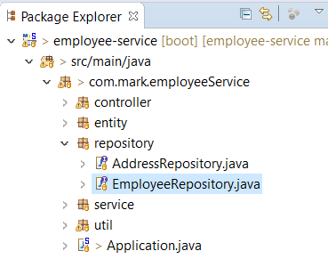
Repository Layer
The Repository layer contains the “data access object” – the class that interacts with the database.

Slide 27
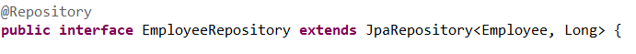
Implementing a Base Repository Class
This class extends the SimpleJpaRepository class, which is the default class that Spring uses to provide implementations for repository interfaces.
Repository annotation
Extends
JPA Repository
Input object and ID

Slide 28
Implemented Methods
The power of Spring makes things more convenient for us.
By implementing this base repository class a number of methods are implemented for us automatically.
Available to call on our repository object in our service layer.

Slide 29
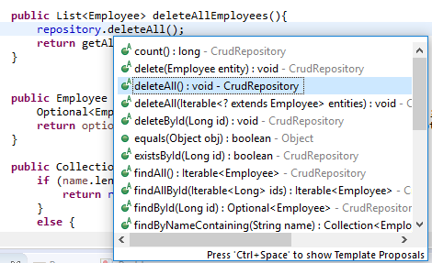

Slide 30
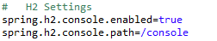
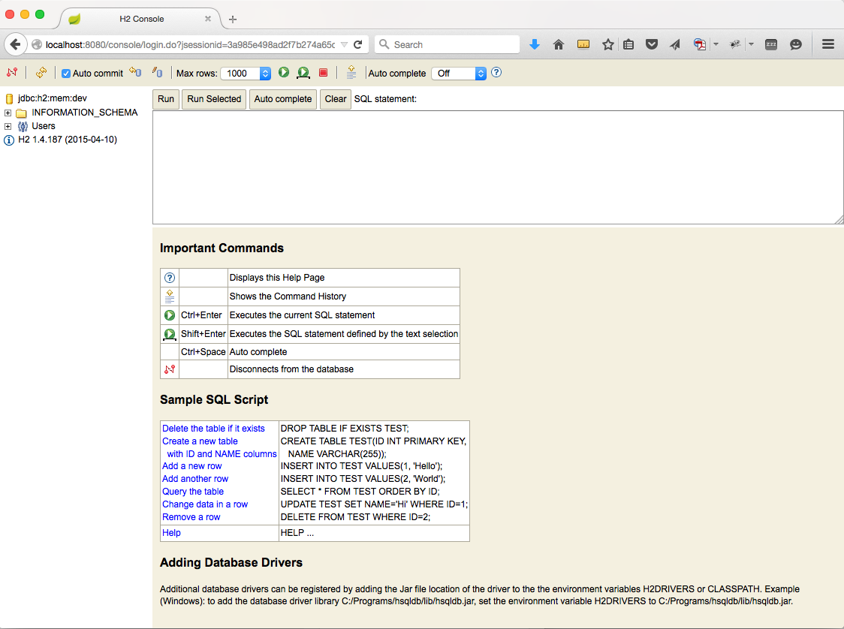
Viewing the database
Verifying changes that your making and viewing your overall database schema its useful to be able to view it in a console.
Additional settings in the application.properties allow us to do this.
A boolean to enable it and the path to reach it, in this instance http://localhost:8080/console

Slide 31
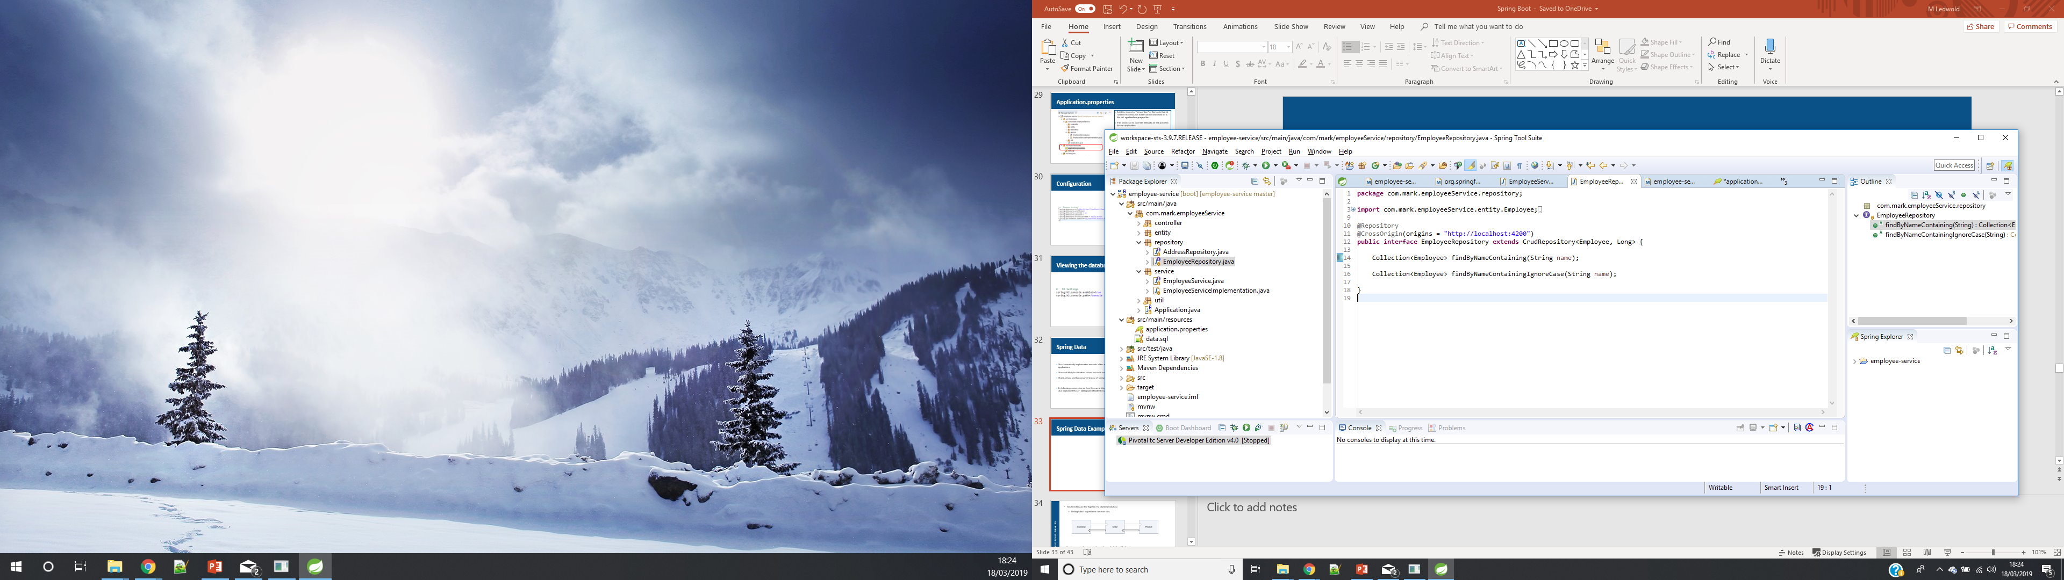
Spring Data
There will likely be situations where you need something more specific to suit the uniqueness of your application.
That is where another powerful feature of Spring comes into play called Spring Data.
By following a convention on how they are written, method stubs can be added to the repository class and spring will also implement these – taking care of both the Java and SQL for you.
the convention to follow for Spring to recognise the intent can be found in the documentation here; https://docs.spring.io/spring-data/jpa/docs/current/reference/html

Slide 32
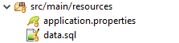
Initialising the Database
When using JPA (Java Persistence API) we have direct way to initialise our database with records.
Adding a file called data.sql to the resources folder (following convention), this file will be read first when the application runs.
By adding SQL queries to this file records can be added so that there is data added to your database when the application starts up.
When using JPA classes annotated with @Entity will be recognised as a table and automatically added to the database before the data.sql file is read.

Slide 33

Enterprise Application Structure
In Spring Boot and Enterprise applications we use SOLID principles, separating out the single responsibility of our classes into layers for extension, readability and maintainability of our code.
Controller
Service
Repository
Our Controller endpoints can be interacted with by other services or by a UI client for a user friendly experience.

Slide 34
Course Objectives - Summary
Discuss the use of Spring Boot within a business context
Spring Boot is used to bring many API’s (existing coding solutions) together to get your application off the ground quickly.
We take advantage of these existing solutions so that it is not necessary for everything to be done from scratch with every new application.
Conventions are used both saving time and encouraging following best practices when structuring an application.
Describe how abstraction and techniques allow us to code at a higher level avoiding low level details
JDBC abstracted away, default configuration, auto-implementation, embedded container, maven dependency management, etc.

Slide 35
Live demo
Create an account class
Discuss the importance of pack/project structure
Build it up through 3 layers – referring to the previous diagrams and working with the delegates

Slide 36
Thank you.
Questions?

